Slide 1
IBM University Engagement Project Submission
“Exploring the Power of Agentic AI with IBM Granite and LangFlow”

Slide 2
Project Tile – Syllabus to Quiz Generator
Domain of Project – Education
Faculty Name | Recent Passport Photo | Email ID | Mobile number [WhatsApp]
Ms. Vishakha Sharma |  | sharmavishakha1209@gmail.com | +91 6395235636

Slide 3
Problem Statement -
Problem Statement : Syllabus to Quiz Generator
The Challenge Students and educators often struggle to convert large, unstructured syllabus content into meaningful assessments. Syllabi may include textbooks, lecture notes, PDFs, and slides spread across multiple sources, making it difficult to identify key concepts and generate relevant questions. Manual quiz creation is time-consuming, inconsistent in quality, and often lacks alignment with learning objectives or difficulty levels. Additionally, adapting quizzes for different learners and tracking progress adds further complexity.
The Objective
Build an agentic AI-powered Syllabus-to-Quiz Generator that acts as an intelligent assessment assistant. The solution should:
Transform Syllabus into Structured Content – Extract and organize topics, subtopics, and key concepts from syllabus documents and learning materials.
Automate Quiz Generation – Generate high-quality quizzes (MCQs, short answers, descriptive) aligned with difficulty levels and learning outcomes.
Enable Adaptive Assessment – Adjust question difficulty based on user performance and learning progress.
Support Multimodal Inputs – Accept PDFs, lecture notes, images, and text to generate quizzes from diverse educational content.
Provide Feedback & Analytics – Offer instant evaluation, explanations, and performance insights through interactive dashboards.
Ensure Personalization – Tailor quizzes based on student level, subject focus, and exam requirements.
This enables a smart, scalable, and efficient system that simplifies assessment creation while improving learning outcomes.

Slide 4
Technology Used
LangFlow + IBM watsonx.ai + Granite Models

Slide 5
Proposed Solution -
Proposed Solution: AI-Powered Syllabus-to-Quiz Agent
The proposed solution is a multi-agent AI-powered Syllabus-to-Quiz Generator built using LangFlow, IBM watsonx.ai, and Granite Models to automate the creation of high-quality assessments from structured and unstructured learning materials. The system addresses challenges in manual quiz creation, content alignment, and adaptive assessment through an intelligent, modular architecture.
At its core, the solution uses a Retrieval-Augmented Generation (RAG) pipeline to extract and process syllabus content from sources such as PDFs, lecture notes, textbooks, and slides. The content is segmented, embedded, and stored in a vector database, enabling accurate retrieval of key topics and concepts for quiz generation.
The system consists of four key agents:
Content Extraction Agent processes syllabus materials (PDFs, notes, images) and converts them into structured topics, subtopics, and key learning points.
Quiz Generation Agent creates diverse question types (MCQs, short answers, descriptive questions) aligned with difficulty levels and learning objectives.
Adaptive Assessment Agent adjusts question difficulty and selection based on user performance, ensuring personalized learning experiences.
Evaluation & Feedback Agent analyzes user responses, provides instant scoring, detailed explanations, and actionable feedback to improve understanding.
The solution includes a user-friendly interface (built with Streamlit or React) that allows users to upload syllabus content, generate quizzes, and visualize performance analytics. Dashboards display accuracy trends, topic-wise strengths and weaknesses, and learning progress over time.
LangFlow orchestrates agent workflows and manages interactions between components, while watsonx.ai ensures scalable model deployment, embeddings, and governance. Granite models power content understanding, question generation, and adaptive reasoning.
Overall, this solution delivers an end-to-end intelligent assessment system that transforms syllabus content into interactive, personalized quizzes—enhancing both teaching efficiency and student learning outcomes.

Slide 6
Langflow component Used -
1) Chat Input – Interface where users enter their queries, preferences, or meal details (text/voice/image).
2) IBM watsonx AI Agent - Processes user input using Granite models to generate personalized nutrition insights and recommendations.
3) Name of IBM Granite model - Granite-4.0-8B-Instruct → Fast, efficient for real-time diet recommendations
4) Chat output -Displays AI-generated responses such as diet plans, nutritional analysis, and health suggestions.

Slide 7
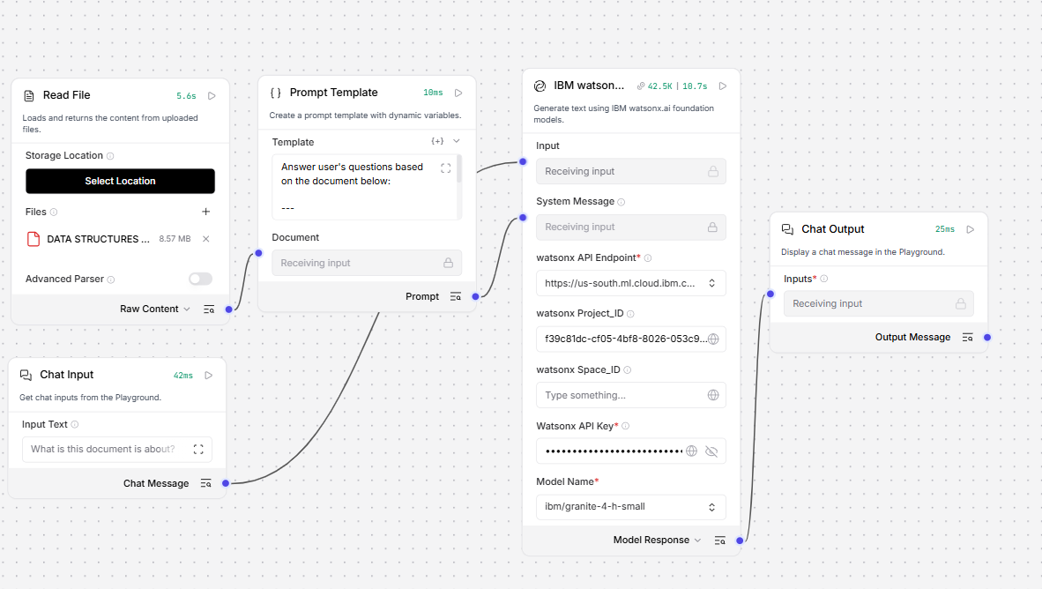
Langflow workflow -

Slide 8
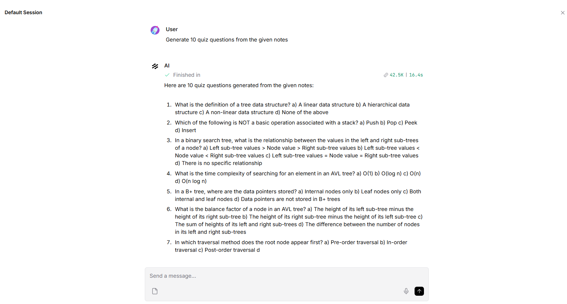
Output-

Slide 9

Architecture blueprint

Slide 10

Role of Agentic AI in the solution
Role of Generative AI in Syllabus-to-Quiz Generator
Generative AI enables the Syllabus-to-Quiz Generator to move beyond static question banks and function as an intelligent content creation system. Using IBM watsonx.ai and Granite Models, it dynamically generates high-quality quiz questions from syllabus content.
It understands and transforms unstructured inputs—such as PDFs, notes, and slides—into meaningful questions across formats like MCQs, short answers, and descriptive types. Generative AI ensures that questions are contextually relevant, aligned with learning objectives, and adaptable to different difficulty levels.
It also enables personalization, creating quizzes tailored to student performance, subject focus, and learning pace. Additionally, it provides instant explanations and feedback, helping learners understand concepts rather than just memorize answers.
Overall, Generative AI makes the system dynamic, scalable, and adaptive—turning syllabus content into interactive assessments that enhance learning and evaluation efficiency.

Slide 11
Technology Used
Langflow platform -For designing and orchestrating multi-agent workflows visually
IBM Grainte model - for eg – ibm-granite-4h-small – For natural language understanding, reasoning, and personalization
IBM Cloud – It provides the infrastructure to build, deploy, and scale the Research Agent efficiently. IBM Cloud enables a reliable, secure, and scalable environment for deploying the Nutrition Agent.
RAG– RAG to fetch real data first, then generate intelligent answers, making the Research Agent more trustworthy and effective.
IBM Watsonx.ai - For model deployment, embeddings, and AI governance

Slide 12
Novelty and Uniqueness
The proposed Syllabus-to-Quiz Generator stands out by combining Agentic AI, RAG, and Generative AI into a unified intelligent assessment system.
Agentic Multi-Component System – Instead of a static quiz generator, multiple specialized agents work together for content extraction, question generation, evaluation, and adaptive learning.
RAG-Driven Accuracy – Uses Retrieval-Augmented Generation to ensure quizzes are directly grounded in syllabus content, reducing irrelevant or hallucinated questions.
Dynamic Generative Questioning – Leverages Granite Models to create diverse, high-quality questions (MCQs, descriptive, conceptual) automatically from learning material.
Adaptive Learning Engine – Continuously adjusts question difficulty based on student performance, enabling personalized assessment paths.
Multimodal Content Understanding – Processes PDFs, lecture notes, images, and text to generate quizzes from any type of syllabus input.
Instant Feedback with Explanations – Provides real-time evaluation along with detailed reasoning for each answer, enhancing conceptual understanding.
Scalable & Intelligent Architecture – Built using IBM watsonx.ai, ensuring secure, scalable, and enterprise-ready deployment.
This makes the solution a smart, adaptive, and fully automated assessment system that goes far beyond traditional quiz generators.

Slide 13
Git Hub Link
Github URL – https://github.com/vishkatyan/SRMIST-SyllabusToQuizGenerator.git
·
·
·

Slide 14
Future Scope
Future Scope of Syllabus-to-Quiz Generator
AI-Driven Personalized Learning Paths – Evolve the system into a fully adaptive learning platform that not only generates quizzes but also creates complete personalized study roadmaps based on student performance and weaknesses.
Autonomous Curriculum Intelligence – Extend capabilities to automatically analyze entire course structures and suggest optimized syllabus redesigns, improving teaching efficiency and learning outcomes.
Voice and Conversational Assessments – Introduce voice-based quiz interaction and chatbot-style exam simulations, enabling more natural and accessible learning experiences across devices.
Real-Time Classroom Integration – Integrate with Learning Management Systems (LMS) to generate live quizzes during lectures, enabling instant student engagement and feedback.
Advanced Skill & Competency Mapping – Map quiz results to specific skills and competencies, helping educators track learning outcomes at a granular level and align them with industry requirements.

Slide 15


